Slide 1

HAND GESTURE LEARNING FOR MUTE PEOPLE
Guided By :
Dr. M. S. S. Rukmini
Professor
Team Members :
P. Sudheer Kousic – 151FA05202
L. Bhanu Vamsi – 151FA05291
T. Sindhuja – 151FA05323

Slide 2
ABSTRACT :
The hand glove fitted with Flex sensors and Arduino Uno as a Controller. All the gestures made by the hand glove (with Flex sensor) is converted into different messages and commands for the operation of different devices. Sign language is a useful tool to ease the communication between the deaf and the mute community and the normal people. This project is useful for differently abled, speech-impaired and paralyzed patients who cannot speak properly. This work is done to check feasibility of recognizing sign language using flex sensor and displaying the data, which proved to be an efficient system.

Slide 3
HARDWARE COMPONENTS :
Arduino UNO
Flex Sensors
APR 33A3 Voice Module
LCD 16*2
Speaker
Bread Board or PCB board
Jumper Wires
Gloves
Resistors
Capacitors

Slide 4
SOFTWARE REQUIRED :
C/C++ Using Arduino Software.

Slide 5
BLOCK DIAGRAM :
POWER SUPPLY
LCD
ARDUINO
UNO
1
2
3
4
5
SPEAKER
APR 33A3 VOICE MODULE
FLEX SENSORS

Slide 6
WORKING :
In general, deaf/dumb people have difficulty in communicating with others who do not understand sign language.
The Hand gesture glove is a normal, cloth driving glove fitted with flex sensors. The sensors output a stream of data that varies with degree of bend made by the fingers.
Flex sensors are sensors that change in resistance depending on the amount of bend on the sensor.
They convert the change in bend to electrical resistance - the more the bend, the more the resistance value.
The output from the sensor is converted to digital and processed by using microcontroller and then it responds in the voice using speaker and it can be displayed on the LCD screen also.

Slide 7
OUTCOMES :
The output from the sensor is converted to digital and processed by using microcontroller and then it responds in the voice using speaker and it can be displayed on the LCD screen also.

Slide 8
LITERATURE SURVEY :
Hand Gesture Recognition And Voice Conversion System For Dumb People :
(V.Padmanabhan, M.Sornalatha)
In our country around 2.78% of peoples are not able to speak (dumb). Their communications with others are only using the motion of their hands and expressions.
We proposed a new technique called artificial speaking mouth for dumb people. It will be very helpful to them for conveying their thoughts to others.
Some peoples are easily able to get the information from their motions. The remaining is not able to understand their way of conveying the message. In order to overcome the complexity the artificial mouth is introduced for the dumb peoples.
This system is based on the motion sensor. According to dumb people, for every motion they have a meaning. That message is kept in a database.
International Journal of Scientific & Engineering Research, Volume 5, Issue 5, May-2014 ISSN 2229-5518 (WWW.IJSER.COM)

Slide 9
Gesture Recognization & Conversion For Deaf And Dumb People:
( Allada Ramesh, B.V.Reddy )
In this system a data glove is used as input device which is normal cloth driving gloves fitted with five flex sensors along the length of each finger and the thumb.
Generally mute people use sign language for communication but the communication is become difficult with others who do not understand sign language.
In this project, microcontroller and sensor based gesture to voice converter is presented. This is basically, a data glove and micro-controller based system.
Flex sensor based data glove can detect all the movements of a hand and microcontroller based system converts some specified movements into human recognizable voice.
International Journal Of innovative Technologies(IJITECH) - ISSN 2321-8665 Vol.04,Issue.03, March-2016, Pages:0525-0526
(WWW.IJITECH.ORG)

Slide 10
PLAN OF COMPLETION :
2-1-2018 | Working on project
3-1-2018 | Installation of software
5-1-2018 | Working on hardware components
8-1-2018 | Software coding
12-1-2018 | Developing code
19-1-2018 | Completion of project

Slide 11
REFERENCES
Ruize Xu, Shengli Zhou, And Wen J. Li, Mems Accelerometer Based Nonspecific-User Hand Gesture Recognition Ieee Sensors Journal, Vol. 12, No. 5, May 2012
C. M. Bishop (2006), Pattern Recognition and Machine Learning, 1st ed. New York: Springer.
S. S. Fels and G. E. Hinton(1993), ―Glove-talk: A neural network interface between a data glove and a speech synthesizer,‖ IEEE Trans. Neural Network.
W. T. Freeman and C. D. Weissman (1995) , ―TV control by hand gestures, ‖presented at the IEEE Int. Workshop on Automatic Face and Gesture Recognition, Zurich, Switzerland.

Slide 12
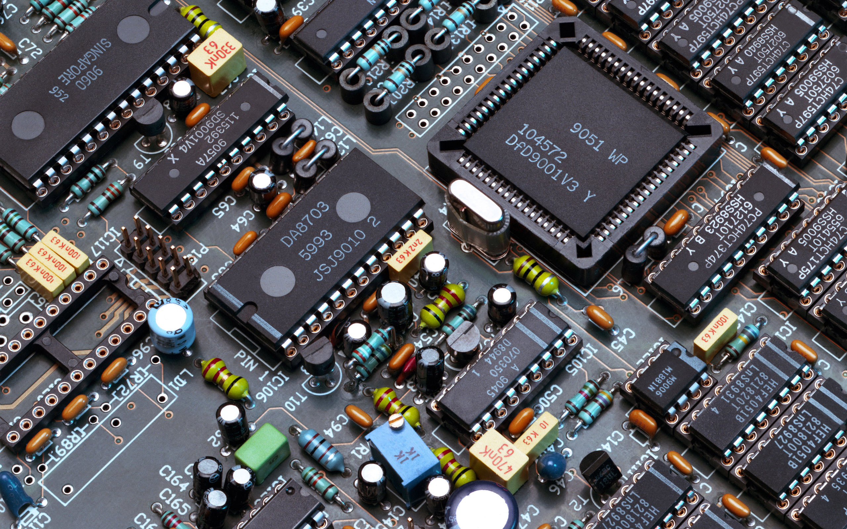
THANK YOU !!!!!!

